Slide 1

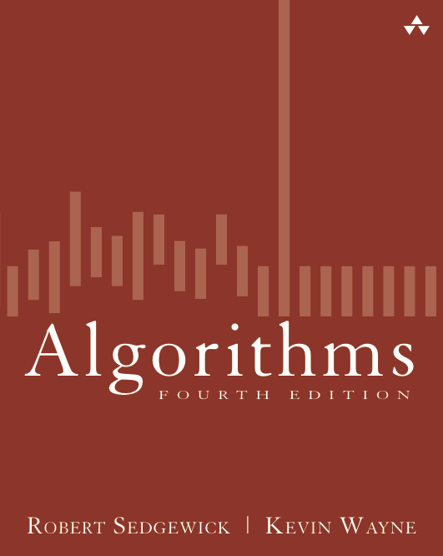
2.3 Quicksort
Algorithms
Robert Sedgewick | Kevin Wayne
http://algs4.cs.princeton.edu
Notes:
music of quicksort: https://googledrive.com/host/0B2GQktu-wcTiMkNBbDFIQnpFcTQ/
wear quicksort t-shirt to class

Slide 2













Two classic sorting algorithms: mergesort and quicksort
Critical components in the world’s computational infrastructure.
Full scientific understanding of their properties has enabled us to develop them into practical system sorts.
Quicksort honored as one of top 10 algorithms of 20th century in science and engineering.
Mergesort. [last lecture]
Quicksort. [this lecture]
...
...
Notes:
Quicksort: a beautiful and efficient algorithm
These two algorithms are among the most important in all of computer science. Not only because they are solve an important and are widely used, but because they demonstrate general techniques.
Mergesort: Java sort for objects. Perl, C++ stable sort, Python stable sort, Firefox, JavaScript, GNU Octave, Android, …
Quicksort: Java sort for primitive types. C, Unix, Visual C++, Python, Matlab, Chrome, JavaScript, …
g++ uses introsort (quicksort with switchover to heapsort for pathological inputs)

Slide 3
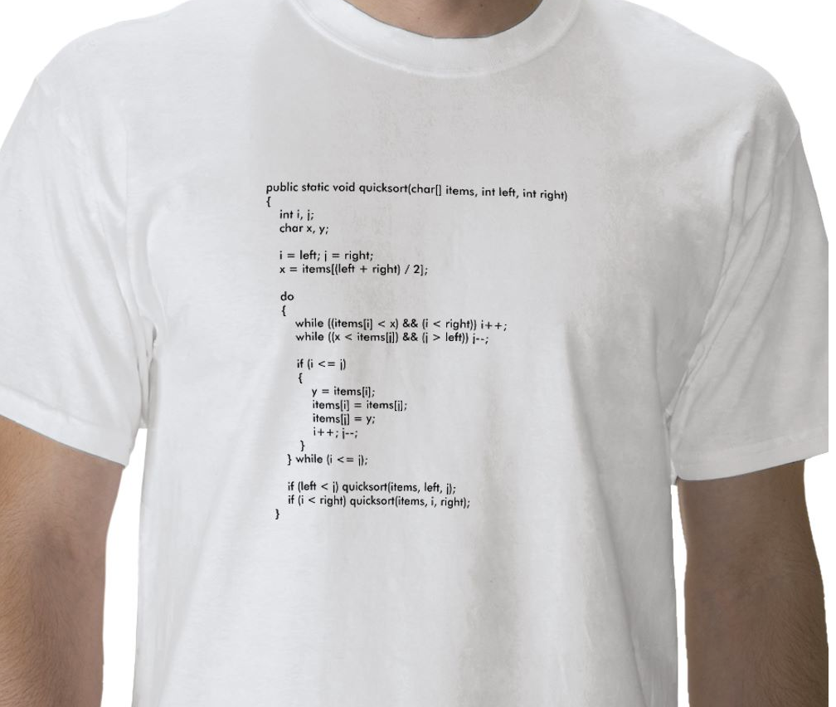
Quicksort t-shirt
Notes:
you can even get a quicksort t-shirt nowadays
version of quicksort memorialized on a t-shirt

Slide 4

Quicksort t-shirt
Notes:
[wayne f13] wear this one to class!

Slide 5
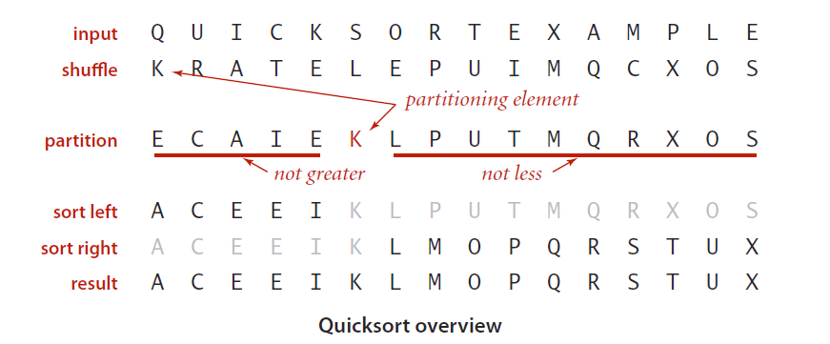
Quicksort
Basic plan.
Shuffle the array.
Partition so that, for some j
entry a[j] is in place
no larger entry to the left of j
no smaller entry to the right of j
Sort each subarray recursively.
Notes:
random shuffle helps with analysis and protects against worst case [stay tuned]

Slide 6

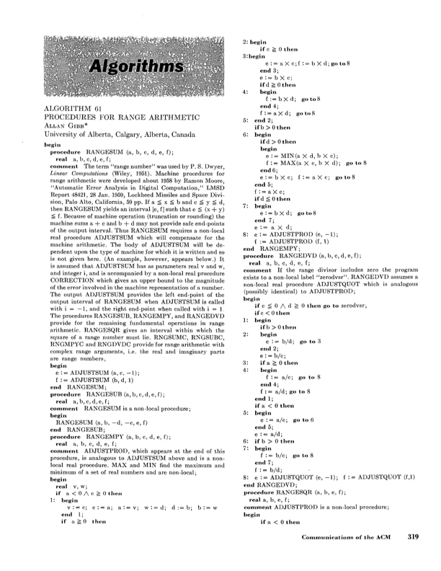
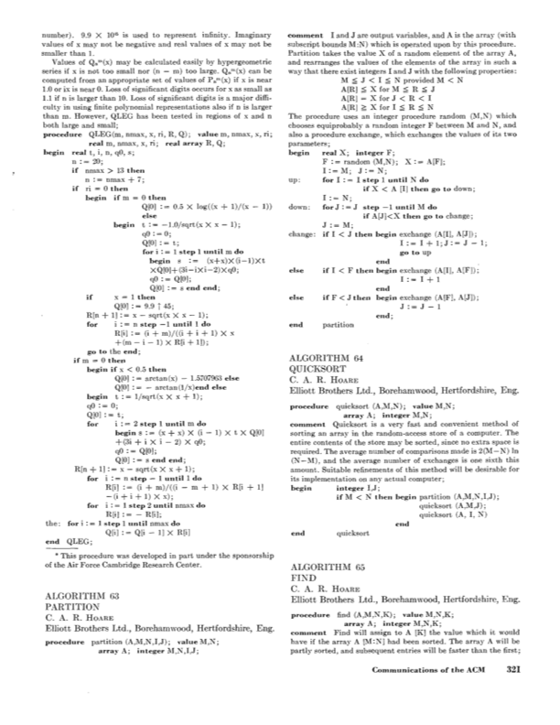
Tony Hoare
Invented (1960) quicksort to translate Russian into English.
[ but couldn't explain his algorithm or implement it! ]
Learned Algol 60 (and recursion).
Implemented quicksort.
Tony Hoare 1980 Turing Award
Communications of the ACM (July 1961)
Notes:
Invented in 1960 while a student at Moscow State University at the age of 26.
He had a hard time explaining his algorithm to his colleagues
failed to implement it in Mercury Autocode because it lacked recursion! That was the only programming language Hoare knew at the time.
Later, he took a class in Algol 60 and succeeded in coding it up.
"Here is a language so far ahead of its time, that it was not only an improvement on its predecessors, but also on nearly all its successors." referring to Algol 60

Slide 7
Tony Hoare
Invented quicksort to translate Russian into English.
[ but couldn't explain his algorithm or implement it! ]
Learned Algol 60 (and recursion).
Implemented quicksort.
“ There are two ways of constructing a software design: One way is
to make it so simple that there are obviously no deficiencies, and
the other way is to make it so complicated that there are no obvious
deficiencies. The first method is far more difficult. ”
Tony Hoare 1980 Turing Award
“ I call it my billion-dollar mistake. It was the invention of the null
reference in 1965… This has led to innumerable errors,
vulnerabilities, and system crashes, which have probably caused
a billion dollars of pain and damage in the last forty years. ”
Notes:
failed to implement it in Mercury Autocode because it lacked recursion! That was the only programming language Hoare knew at the time.
Invented while a student at Moscow State University at the age of 26.
Later, he took a class in Algol 60.

Slide 8

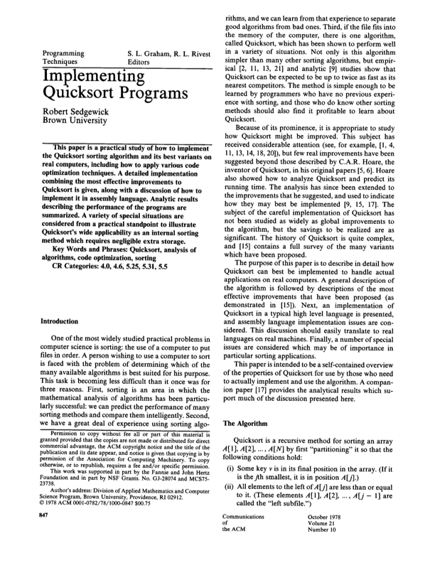
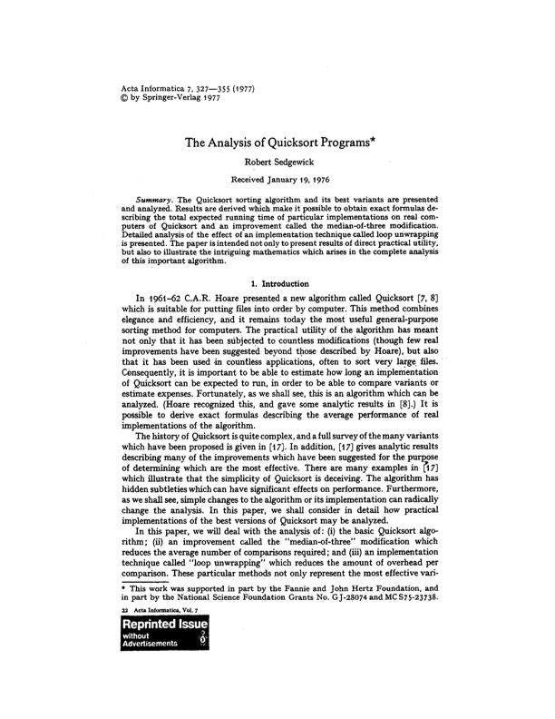
Bob Sedgewick
Refined and popularized quicksort.
Analyzed quicksort.
Bob Sedgewick
Notes:
found performance bug in Knuth's implementation of quicksort
phd thesis = quicksort (with Knuth as advisor)

Slide 9
Quicksort partitioning demo
Repeat until i and j pointers cross.
Scan i from left to right so long as (a[i] < a[lo]).
Scan j from right to left so long as (a[j] > a[lo]).
Exchange a[i] with a[j].
K | R | A | T | E | L | E | P | U | I | M | Q | C | X | O | S
lo
i
j
See demo
Notes:
23DemoPartitioning.key

Slide 10
Quicksort partitioning demo
Repeat until i and j pointers cross.
Scan i from left to right so long as (a[i] < a[lo]).
Scan j from right to left so long as (a[j] > a[lo]).
Exchange a[i] with a[j].
When pointers cross.
Exchange a[lo] with a[j].
E | C | A | I | E | K | L | P | U | T | M | Q | R | X | O | S
lo
j
hi
partitioned!

Slide 11
Quicksort partitioning demo
Repeat until i and j pointers cross.
Scan i from left to right so long as (a[i] < a[lo]).
Scan j from right to left so long as (a[j] > a[lo]).
Exchange a[i] with a[j].
K | R | A | T | E | L | E | P | U | I | M | Q | C | X | O | S
lo
i
j
stop i scan because a[i] >= a[lo]

Slide 12
Quicksort partitioning demo
Repeat until i and j pointers cross.
Scan i from left to right so long as (a[i] < a[lo]).
Scan j from right to left so long as (a[j] > a[lo]).
Exchange a[i] with a[j].
K | R | A | T | E | L | E | P | U | I | M | Q | C | X | O | S
lo
i
j

Slide 13
Quicksort partitioning demo
Repeat until i and j pointers cross.
Scan i from left to right so long as (a[i] < a[lo]).
Scan j from right to left so long as (a[j] > a[lo]).
Exchange a[i] with a[j].
K | R | A | T | E | L | E | P | U | I | M | Q | C | X | O | S
lo
i
j

Slide 14
Quicksort partitioning demo
Repeat until i and j pointers cross.
Scan i from left to right so long as (a[i] < a[lo]).
Scan j from right to left so long as (a[j] > a[lo]).
Exchange a[i] with a[j].
K | R | A | T | E | L | E | P | U | I | M | Q | C | X | O | S
lo
i
j
stop j scan and exchange a[i] with a[j]

Slide 15
Quicksort partitioning demo
Repeat until i and j pointers cross.
Scan i from left to right so long as (a[i] < a[lo]).
Scan j from right to left so long as (a[j] > a[lo]).
Exchange a[i] with a[j].
K | C | A | T | E | L | E | P | U | I | M | Q | R | X | O | S
lo
i
j

Slide 16
Quicksort partitioning demo
Repeat until i and j pointers cross.
Scan i from left to right so long as (a[i] < a[lo]).
Scan j from right to left so long as (a[j] > a[lo]).
Exchange a[i] with a[j].
K | C | A | T | E | L | E | P | U | I | M | Q | R | X | O | S
lo
i
j

Slide 17
Quicksort partitioning demo
Repeat until i and j pointers cross.
Scan i from left to right so long as (a[i] < a[lo]).
Scan j from right to left so long as (a[j] > a[lo]).
Exchange a[i] with a[j].
K | C | A | T | E | L | E | P | U | I | M | Q | R | X | O | S
lo
i
j
stop i scan because a[i] >= a[lo]

Slide 18
Quicksort partitioning demo
Repeat until i and j pointers cross.
Scan i from left to right so long as (a[i] < a[lo]).
Scan j from right to left so long as (a[j] > a[lo]).
Exchange a[i] with a[j].
K | C | A | T | E | L | E | P | U | I | M | Q | R | X | O | S
lo
i
j

Slide 19
Quicksort partitioning demo
Repeat until i and j pointers cross.
Scan i from left to right so long as (a[i] < a[lo]).
Scan j from right to left so long as (a[j] > a[lo]).
Exchange a[i] with a[j].
K | C | A | T | E | L | E | P | U | I | M | Q | R | X | O | S
lo
i
j

Slide 20
Quicksort partitioning demo
Repeat until i and j pointers cross.
Scan i from left to right so long as (a[i] < a[lo]).
Scan j from right to left so long as (a[j] > a[lo]).
Exchange a[i] with a[j].
K | C | A | T | E | L | E | P | U | I | M | Q | R | X | O | S
lo
i
j
stop j scan and exchange a[i] with a[j]

Slide 21
Quicksort partitioning demo
Repeat until i and j pointers cross.
Scan i from left to right so long as (a[i] < a[lo]).
Scan j from right to left so long as (a[j] > a[lo]).
Exchange a[i] with a[j].
K | C | A | I | E | L | E | P | U | T | M | Q | R | X | O | S
lo
i
j

Slide 22
Quicksort partitioning demo
Repeat until i and j pointers cross.
Scan i from left to right so long as (a[i] < a[lo]).
Scan j from right to left so long as (a[j] > a[lo]).
Exchange a[i] with a[j].
K | C | A | I | E | L | E | P | U | T | M | Q | R | X | O | S
lo
i
j

Slide 23
Quicksort partitioning demo
Repeat until i and j pointers cross.
Scan i from left to right so long as (a[i] < a[lo]).
Scan j from right to left so long as (a[j] > a[lo]).
Exchange a[i] with a[j].
K | C | A | I | E | L | E | P | U | T | M | Q | R | X | O | S
lo
i
j
stop i scan because a[i] >= a[lo]

Slide 24
Quicksort partitioning demo
Repeat until i and j pointers cross.
Scan i from left to right so long as (a[i] < a[lo]).
Scan j from right to left so long as (a[j] > a[lo]).
Exchange a[i] with a[j].
K | C | A | I | E | L | E | P | U | T | M | Q | R | X | O | S
lo
i
j

Slide 25
Quicksort partitioning demo
Repeat until i and j pointers cross.
Scan i from left to right so long as (a[i] < a[lo]).
Scan j from right to left so long as (a[j] > a[lo]).
Exchange a[i] with a[j].
K | C | A | I | E | L | E | P | U | T | M | Q | R | X | O | S
lo
i
j

Slide 26
Quicksort partitioning demo
Repeat until i and j pointers cross.
Scan i from left to right so long as (a[i] < a[lo]).
Scan j from right to left so long as (a[j] > a[lo]).
Exchange a[i] with a[j].
K | C | A | I | E | L | E | P | U | T | M | Q | R | X | O | S
lo
i
j
stop j scan and exchange a[i] with a[j]

Slide 27
Quicksort partitioning demo
Repeat until i and j pointers cross.
Scan i from left to right so long as (a[i] < a[lo]).
Scan j from right to left so long as (a[j] > a[lo]).
Exchange a[i] with a[j].
K | C | A | I | E | E | L | P | U | T | M | Q | R | X | O | S
lo
i
j

Slide 28
Quicksort partitioning demo
Repeat until i and j pointers cross.
Scan i from left to right so long as (a[i] < a[lo]).
Scan j from right to left so long as (a[j] > a[lo]).
Exchange a[i] with a[j].
K | C | A | I | E | E | L | P | U | T | M | Q | R | X | O | S
lo
i
j
stop i scan because a[i] >= a[lo]

Slide 29
Quicksort partitioning demo
Repeat until i and j pointers cross.
Scan i from left to right so long as (a[i] < a[lo]).
Scan j from right to left so long as (a[j] > a[lo]).
Exchange a[i] with a[j].
K | C | A | I | E | E | L | P | U | T | M | Q | R | X | O | S
lo
j
i
stop j scan because a[j] <= a[lo]

Slide 30
Quicksort partitioning demo
Repeat until i and j pointers cross.
Scan i from left to right so long as (a[i] < a[lo]).
Scan j from right to left so long as (a[j] > a[lo]).
Exchange a[i] with a[j].
When pointers cross.
Exchange a[lo] with a[j].
K | C | A | I | E | E | L | P | U | T | M | Q | R | X | O | S
lo
j
i
pointers cross: exchange a[lo] with a[j]

Slide 31
Quicksort partitioning demo
Repeat until i and j pointers cross.
Scan i from left to right so long as (a[i] < a[lo]).
Scan j from right to left so long as (a[j] > a[lo]).
Exchange a[i] with a[j].
When pointers cross.
Exchange a[lo] with a[j].
E | C | A | I | E | K | L | P | U | T | M | Q | R | X | O | S
lo
j
hi
partitioned!

Slide 32
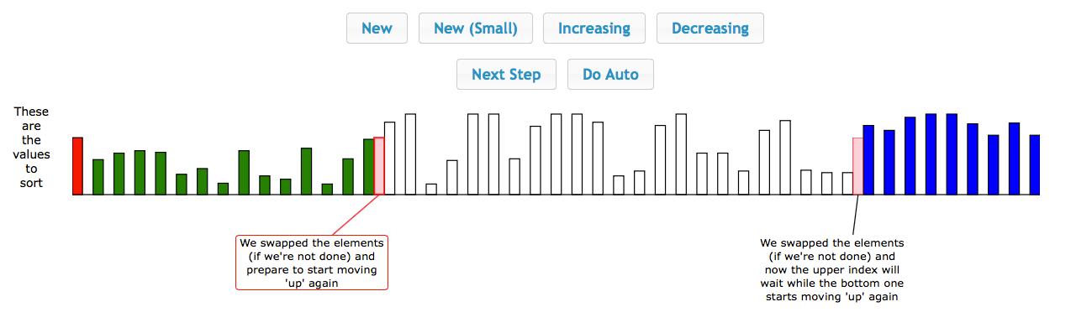
The music of quicksort partitioning (by Brad Lyon)
https://googledrive.com/host/0B2GQktu-wcTicjRaRjV1NmRFN1U/index.html
Notes:
quicksort partitioning sonification

Slide 33
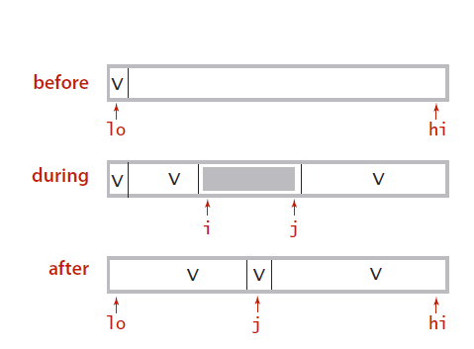
Quicksort: code for partitioning
private static int partition(int a[], int lo, int hi)
{
int i = lo, j = hi+1;
while (true)
{
while (small(a[++i], a[lo]))
if (i == hi) break;
while (small(a[lo], a[--j]))
if (j == lo) break;
if (i >= j) break;
swap(a, i, j);
}
swap(a, lo, j);
return j;
}
find item on left to swap
find item on right to swap
check if pointers cross
swap
swap with partitioning item
return index of item now known to be in place
Notes:
Knuth reports horror stories of bad implementations of partitioning that go quadratic
straightforward with auxiliary array, better solution: uses constant extra space and still N-1 compares

Slide 34
Quicksort: Java implementation
class Quick
{
int partition(int a[], int lo, int hi)
{ /* see previous slide */ }
void sort(int a[])
{
StdRandom.shuffle(a);
sort(a, 0, a.length - 1);
}
void sort(int a[], int lo, int hi)
{
if (hi <= lo) return;
int j = partition(a, lo, hi);
sort(a, lo, j-1);
sort(a, j+1, hi);
}
}
shuffle needed for performance guarantee
(stay tuned)

Slide 35
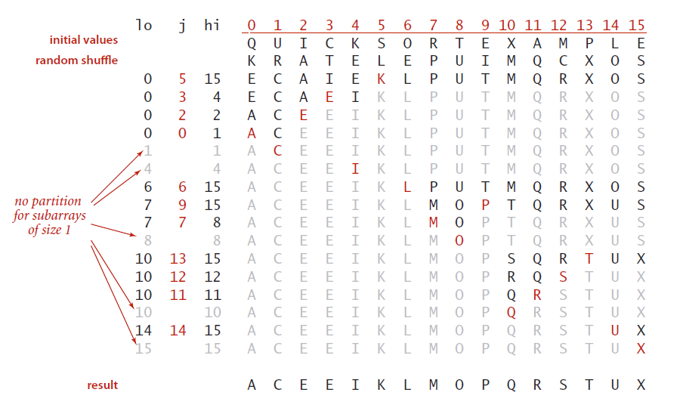
Quicksort trace

Slide 36

Quicksort animation
50 random items
algorithm position
in order
current subarray
not in order
http://www.sorting-algorithms.com/quick-sort
Notes:
this version partitions on random item (instead of shuffling and partitioning on leftmost item)

Slide 37
Quicksort: implementation details
Partitioning in-place. Using an extra array makes partitioning easier (and stable), but is not worth the cost.
Terminating the loop. Testing whether the pointers cross is trickier than it might seem.
Equal keys. When duplicates are present, it is (counter-intuitively) better to stop scans on keys equal to the partitioning item's key.
Preserving randomness. Shuffling is needed for performance guarantee.
Equivalent alternative. Pick a random partitioning item in each subarray.
Notes:
testing whether the pointer cross is a bit tricky, especially in the presence of duplicate keys
why is (j == lo) test redundant? Partitioning item is there.
Staying in bounds. The (j == lo) test is redundant (why?), but the (i == hi) test is not.
j == lo) test redundant because partitioning element a[lo] asks as a sentinel

Slide 38
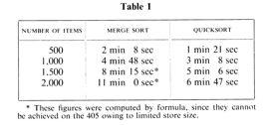
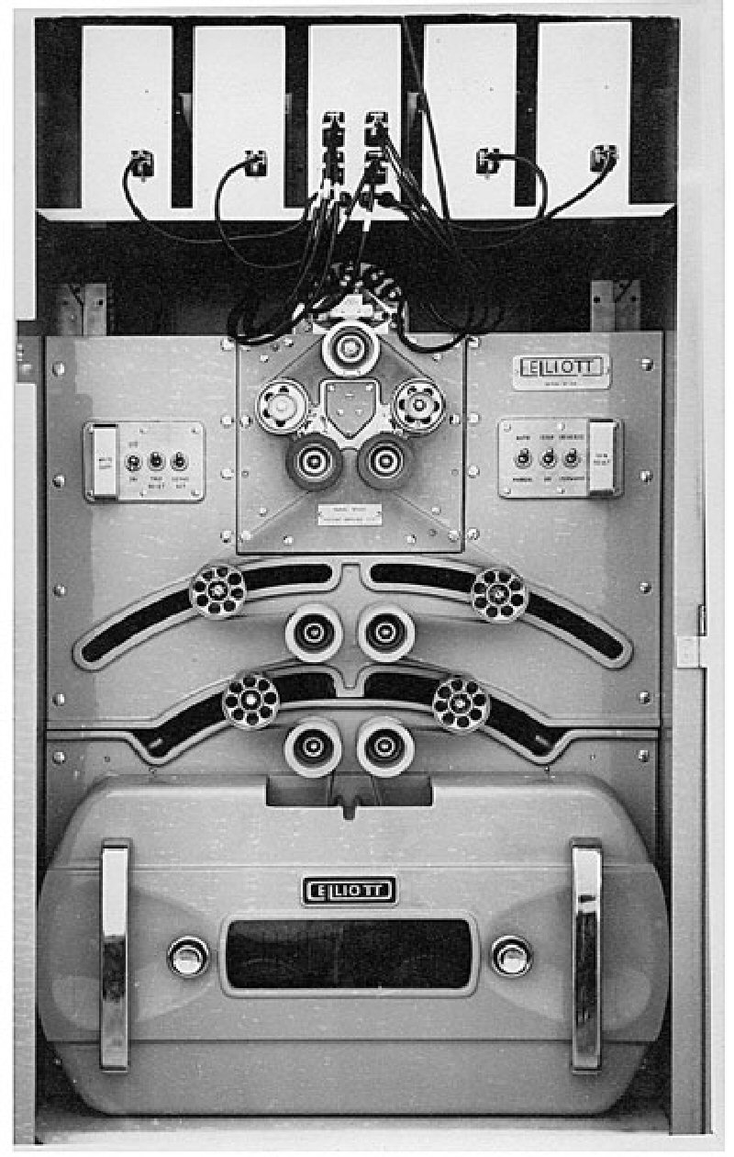
Quicksort: empirical analysis (1961)
Running time estimates:
Algol 60 implementation.
National-Elliott 405 computer.
sorting N 6-word items with 1-word keys
Elliott 405 magnetic disc
(16K words)
Notes:
Quicksort by C. A. R. Hoare. The Computer Journal, Vol. 5, No. 1, pp. 10-16 (1962).

Slide 39
Quicksort: empirical analysis
Running time estimates:
Home PC executes 10⁸ compares/second.
Supercomputer executes 10¹² compares/second.
Lesson 1. Good algorithms are better than supercomputers.
Lesson 2. Great algorithms are better than good ones.
 | insertion sort (N²) |  |  | mergesort (N log N) |  |  | quicksort (N log N)
computer | thousand | million | billion | thousand | million | billion | thousand | million | billion
home | instant | 2.8 hours | 317 years | instant | 1 second | 18 min | instant | 0.6 sec | 12 min
super | instant | 1 second | 1 week | instant | instant | instant | instant | instant | instant

Slide 40
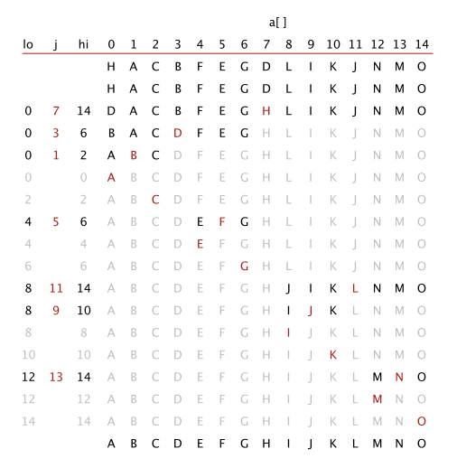
Quicksort: best-case analysis
Best case. Number of compares is ~ N lg N.
initial values
random shuffle
Notes:
every partition divides array in half. Then, same analysis as mergesort divide-and-conquer recurrence. How to find such an input? Use recursion.
Here, we assume random shuffle leaves array in same order as original

Slide 41
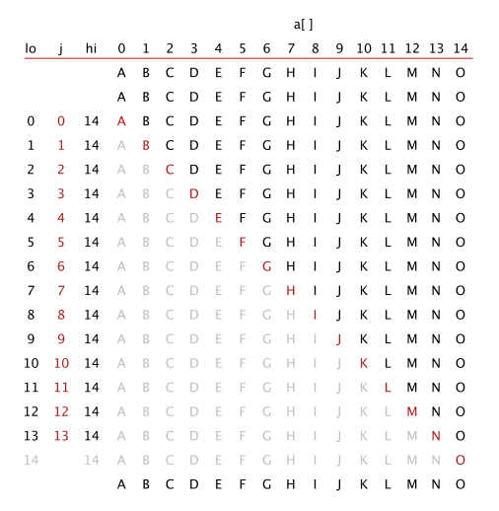
Quicksort: worst-case analysis
Worst case. Number of compares is ~ ½ N ² .
initial values
random shuffle
Notes:
every partition divides array in one piece of size 0 and one of size N-1
Here, we assume random shuffle leaves array in same order as original

Slide 42
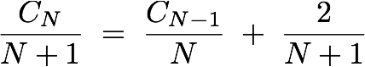
Quicksort: average-case analysis
Proposition. The average number of compares C_{N} to quicksort an array of N distinct keys is ~ 2N ln N (and the number of exchanges is ~ ⅓ N ln N ).
Pf. C_{N} satisfies the recurrence C₀ = C₁ = 0 and for N ≥ 2:
Multiply both sides by N and collect terms:
Subtract from this equation the same equation for N − 1:
Rearrange terms and divide by N (N + 1):
partitioning
left
right
partitioning probability
Notes:
[wayne s14] setting up recurrence is worthwhile. Don't need to cover details of proof.
The N+1 arises if the input is in ascending order. In this case the left scan does N compares and the right scan does 1 compare.
Technically, it should be C_N <= (N+1) + ...
This looks like a fairly daunting equation to solve.

Slide 43
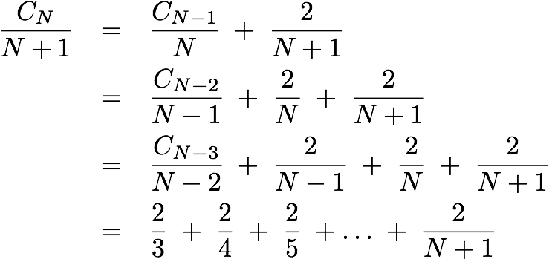
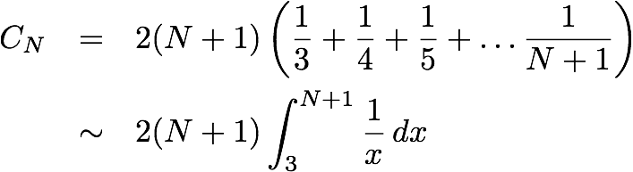
Quicksort: average-case analysis
Repeatedly apply above equation:
Approximate sum by an integral:
Finally, the desired result:
substitute previous equation
previous equation
Notes:
The first ~ is for approximating discrete sum by continuous sum

Slide 44
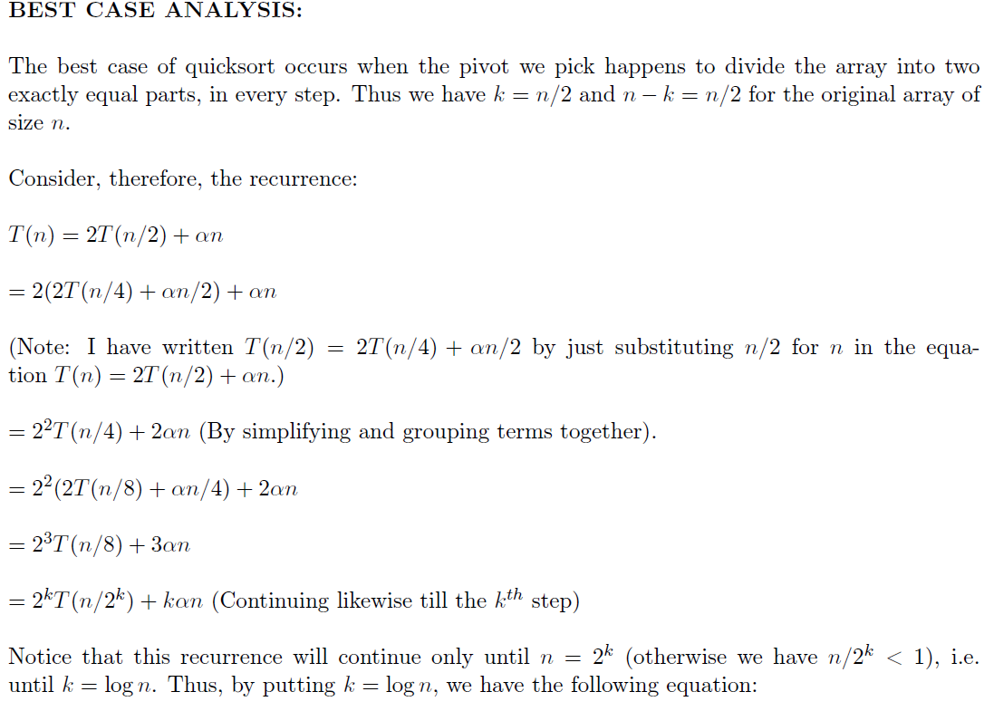
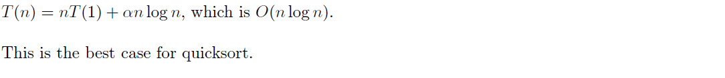
Quicksort: BEST Case analysis
Notes:
[wayne s14] this proof is more insightful, but more difficult for students to grasp key concept (that probability i-j getting compared is 2 / |j-i+1|

Slide 45
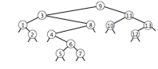
Quicksort: average-case analysis
Proposition. The average number of compares C_{N} to quicksort an array of N distinct keys is ~ 2N ln N (and the number of exchanges is ~ ⅓ N ln N).
Pf 2. Consider BST representation of keys 1 to N.
shuffle
9 | 10 | 2 | 5 | 8 | 7 | 6 | 1 | 11 | 12 | 13 | 3 | 4
first partitioning
item
first partitioning
item in
left subarray
Notes:
[wayne s14] this proof is more insightful, but more difficult for students to grasp key concept (that probability i-j getting compared is 2 / |j-i+1|

Slide 46
Quicksort: average-case analysis
Proposition. The average number of compares C_{N} to quicksort an array of N distinct keys is ~ 2N ln N (and the number of exchanges is ~ ⅓ N ln N).
Pf 2. Consider BST representation of keys 1 to N.
A key is compared only with its ancestors and descendants.
Probability i and j are compared equals 2 / | j − i + 1|.
3 and 6 are compared (when 3 is partition)
1 and 6 are not compared (because 3 is partition)
first partitioning
item
first partitioning
item in
left subarray
Notes:
For example, probability that two adjacent keys gets compared = 1
2 and 8 compared with probability 2/7 - only if 2 or 8 is chosen as partitioning item instead of 3, 4, 5, 6, or 7

Slide 47
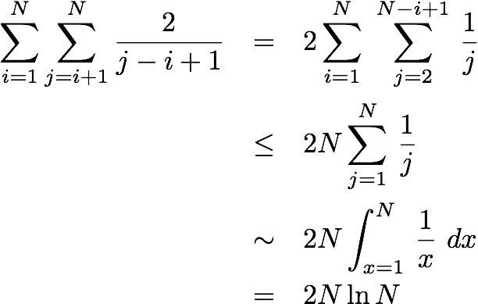
Quicksort: average-case analysis
Proposition. The average number of compares C_{N} to quicksort an array of N distinct keys is ~ 2N ln N (and the number of exchanges is ~ ⅓ N ln N).
Pf 2. Consider BST representation of keys 1 to N.
A key is compared only with its ancestors and descendants.
Probability i and j are compared equals 2 / | j − i + 1|.
Expected number of compares =
all pairs i and j

Slide 48

Quicksort: summary of performance characteristics
Quicksort is a (Las Vegas) randomized algorithm.
Guaranteed to be correct.
Running time depends on random shuffle.
Average case. Expected number of compares is ~ 1.39 N lg N.
39% more compares than mergesort.
Faster than mergesort in practice because of
Best case. Number of compares is ~ N lg N. Worst case. Number of compares is ~ ½ N ².
[ but more likely that lightning bolt strikes computer during execution ]
less data movement
Notes:
For 1 million random items, it is fantastically unlikely that it will take longer than expected.
variance of number of compares ~ (7 - 2 pi^2 / 3) N^2. But distribution is not normal.
Think roughly the odds of being trampled by a herd of zebra above the Arctic Circle, while being hit by a meteor and lightning bolt.
Implementation is fragile.
less data movement includes both data movement from exchanges and from cache misses
Probabilistic guarantee against worst case.
Basis for math model that can be validated with experiments.

Slide 49
Quicksort properties
Proposition. Quicksort is an in-place sorting algorithm.
Pf.
Partitioning: constant extra space.
Depth of recursion: logarithmic extra space (with high probability).
Proposition. Quicksort is not stable.
Pf. [ by counterexample ]
can guarantee logarithmic depth by recurring
on smaller subarray before larger subarray
(requires using an explicit stack)
i | j | 0 | 1 | 2 | 3
 |  | B1 | C1 | C2 | A1
1 | 3 | B1 | C1 | C2 | A1
1 | 3 | B1 | A1 | C2 | C1
0 | 1 | A1 | B1 | C2 | C1

Slide 50
Quicksort: practical improvements
Insertion sort small subarrays.
Even quicksort has too much overhead for tiny subarrays.
Cutoff to insertion sort for ∼ 10 items.
private static void sort(Comparable[] a, int lo, int hi)
{
if (hi <= lo + CUTOFF - 1)
{
Insertion.sort(a, lo, hi);
return;
}
int j = partition(a, lo, hi);
sort(a, lo, j-1);
sort(a, j+1, hi);
}
Notes:
Note: could delay insertion sort until one pass at end. (but better not to because of caching)

Slide 51
Quicksort: practical improvements
Median of sample.
Best choice of pivot item = median.
Estimate true median by taking median of sample.
Median-of-3 (random) items.
~ 12/7 N ln N compares (14% less)
~ 12/35 N ln N exchanges (3% more)
private static void sort(Comparable[] a, int lo, int hi)
{
if (hi <= lo) return;
int median = medianOf3(a, lo, lo + (hi - lo)/2, hi);
swap(a, lo, median);
int j = partition(a, lo, hi);
sort(a, lo, j-1);
sort(a, j+1, hi);
}
Notes:
Non-recursive version: Use explicit stack; always sort smaller half first (guaranteed O(log N) stack size).
Increases number of exchanges paradoxically, but this happens when partitions are right in the middle.

Slide 52
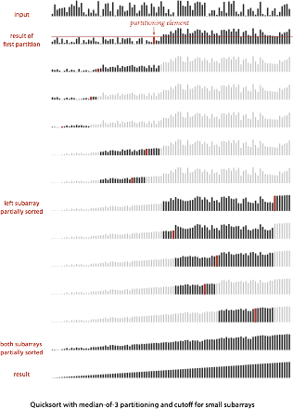
Quicksort with median-of-3 and cutoff to insertion sort: visualization
Notes:
median-of-3 partitioning

Slide 53
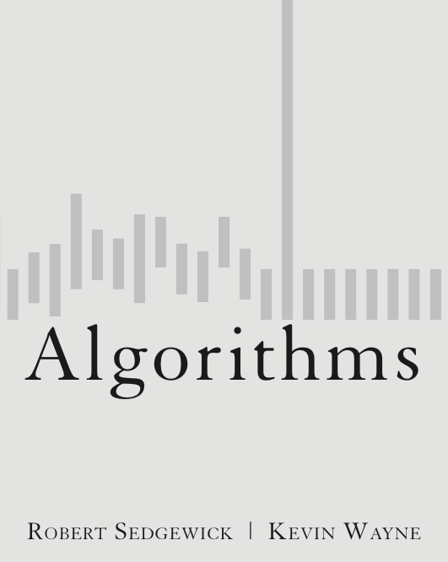
2.3 Quicksort
quicksort
selection
duplicate keys
system sorts
http://algs4.cs.princeton.edu

Slide 54
2.3 Quicksort
quicksort
selection
duplicate keys
system sorts
http://algs4.cs.princeton.edu

Slide 55
Selection
Goal. Given an array of N items, find the k^{th} smallest item.
Ex. Min (k = 0), max (k = N − 1), median (k = N / 2).
Applications.
Order statistics.
Find the "top k."
Use theory as a guide.
Easy N log N upper bound. How?
Easy N upper bound for k = 1, 2, 3. How?
Easy N lower bound. Why?
Which is true?
N log N lower bound?
N upper bound?
is selection as hard as sorting?
is there a linear-time algorithm?
Notes:
Ask students to supply easy upper and lower bounds.
O(N log N) upper bound: sort, return a[k].
O(N) upper bound for min, max.
Omega(N) lower bound: must examine every element.

Slide 56

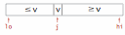
Quick-select
Partition array so that:
Entry a[j] is in place.
No larger entry to the left of j.
No smaller entry to the right of j.
Repeat in one subarray, depending on j; finished when j equals k.
public static Comparable select(Comparable[] a, int k)
{
StdRandom.shuffle(a);
int lo = 0, hi = a.length - 1;
while (hi > lo) {
int j = partition(a, lo, hi);
if (j < k) lo = j + 1;
else if (j > k) hi = j - 1;
else return a[k];
}
return a[k];
}
if a[k] is here
set hi to j-1
if a[k] is here
set lo to j+1

Slide 57
Quick-select: mathematical analysis
Proposition. Quick-select takes linear time on average.
Pf sketch.
Intuitively, each partitioning step splits array approximately in half: N + N / 2 + N / 4 + … + 1 ~ 2N compares.
Formal analysis similar to quicksort analysis yields:
Ex: (2 + 2 ln 2) N ≈ 3.38 N compares to find median.
C_{N} = 2 N + 2 k ln (N / k) + 2 (N – k) ln (N / (N – k))
Notes:
proof is quite a bit more complicated than the one for quicksort
Remark. Quick-select uses ~ ½ N 2 compares in the worst case, but (as with quicksort) the random shuffle provides a probabilistic guarantee.
Note: using median-of-3 speeds up quickselect too. (Surprising dual-pivot versions do not!)

Slide 58
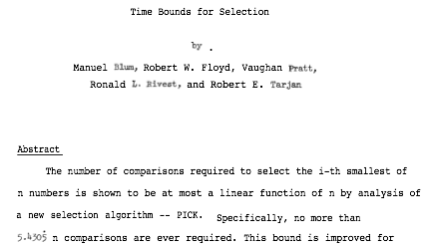
Theoretical context for selection
Proposition. [Blum, Floyd, Pratt, Rivest, Tarjan, 1973] Compare-based selection algorithm whose worst-case running time is linear.
Remark. Constants are high ⇒ not used in practice.
Use theory as a guide.
Still worthwhile to seek practical linear-time (worst-case) algorithm.
Until one is discovered, use quick-select if you don’t need a full sort.
Notes:
famous paper that solved this open problem.
Challenge. Design algorithm whose worst-case running time is linear.
3.3863 N compares (on average for quick select) vs. 5.4305 N for linear select.

Slide 59
Generic methods
In our select() implementation, client needs a cast.
The compiler complains.
Q. How to fix?
Double[] a = new Double[N];
for (int i = 0; i < N; i++)
a[i] = StdRandom.uniform();
Double median = (Double) Quick.select(a, N/2);
unsafe cast required in client
% javac Quick.java
Note: Quick.java uses unchecked or unsafe operations.
Note: Recompile with -Xlint:unchecked for details.
Notes:
cast is hazardous because it can produce an error at run-time instead of compile time

Slide 60
Generic methods
Pedantic (safe) version. Compiles cleanly, no cast needed in client.
Remark. Ugly code used in system sort; not in this course.
public class QuickPedantic
{
public static <Key extends Comparable<Key>> Key select(Key[] a, int k)
{ /* as before */ }
public static <Key extends Comparable<Key>> void sort(Key[] a)
{ /* as before */ }
private static <Key extends Comparable<Key>> int partition(Key[] a, int lo, int hi)
{ /* as before */ }
private static <Key extends Comparable<Key>> boolean less(Key v, Key w)
{ /* as before */ }
private static <Key extends Comparable<Key>> void exch(Key[] a, int i, int j)
{ Key swap = a[i]; a[i] = a[j]; a[j] = swap; }
}
generic type variable (value inferred from argument a[])
return type matches array type
can declare variables of generic type
http://algs4.cs.princeton.edu/23quicksort/QuickPedantic.java.html

Slide 61
2.3 Quicksort
quicksort
selection
duplicate keys
system sorts
http://algs4.cs.princeton.edu

Slide 62
2.3 Quicksort
quicksort
selection
duplicate keys
system sorts
http://algs4.cs.princeton.edu

Slide 63
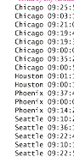
Duplicate keys
Often, purpose of sort is to bring items with equal keys together.
Sort population by age.
Remove duplicates from mailing list.
Sort job applicants by college attended.
Typical characteristics of such applications.
Huge array.
Small number of key values.
key

Slide 64
Duplicate keys
Quicksort with duplicate keys. Algorithm can go quadratic unless partitioning stops on equal keys!
Caveat emptor. Some textbook (and commercial) implementations go quadratic when many duplicate keys.
S T O P O N E Q U A L K E Y S
swap
if we don't stop on equal keys
if we stop on equal keys
Notes:
Mergesort with duplicate keys. Between ~ ½ N lg N and ~ N lg N compares.

Slide 65
What is the result of partitioning the following array?
A.
B.
C.
A | A | A | A | A | A | A | A | A | A | A | A | A | A | A | A
A | A | A | A | A | A | A | A | A | A | A | A | A | A | A | A
A | A | A | A | A | A | A | A | A | A | A | A | A | A | A | A
A | A | A | A | A | A | A | A | A | A | A | A | A | A | A | A

Slide 66
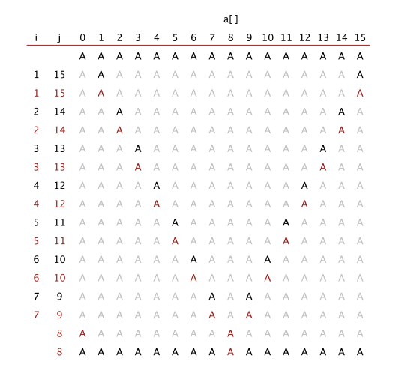
Partitioning an array with all equal keys

Slide 67
Duplicate keys: the problem
Recommended. Stop scans on items equal to the partitioning item. Consequence. ~ N lg N compares when all keys equal.
Mistake. Don't stop scans on items equal to the partitioning item. Consequence. ~ ½ N ² compares when all keys equal.
Desirable. Put all items equal to the partitioning item in place.
B A A B A B C C B C B A A A A A A A A A A A
B A A B A B B B C C C A A A A A A A A A A A
A A A B B B B B C C C A A A A A A A A A A A
Notes:
Assume all keys are equal. Recursive code guarantees this case predominates!

Slide 68
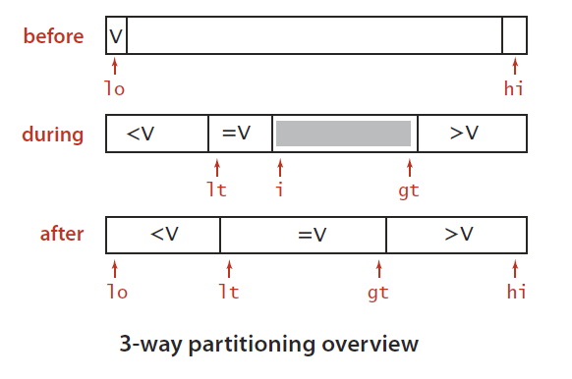

3-way partitioning
Goal. Partition array into three parts so that:
Entries between lt and gt equal to the partition item.
No larger entries to left of lt.
No smaller entries to right of gt.
Dutch national flag problem. [Edsger Dijkstra]
Conventional wisdom until mid 1990s: not worth doing.
Now incorporated into C library qsort() and Java 6 system sort.
Notes:
Dijkstra proposed this as a programming challenge in the 1970s. He was interested in proving correctness about programs.
Not easy to implement efficiently in-place. (Try it!)

Slide 69
Dijkstra 3-way partitioning demo
Let v be partitioning item a[lo].
Scan i from left to right.
(a[i] < v): exchange a[lt] with a[i]; increment both lt and i
(a[i] > v): exchange a[gt] with a[i]; decrement gt
(a[i] == v): increment i
lt
i
gt
P | A | B | X | W | P | P | V | P | D | P | C | Y | Z
lo
hi
invariant
Notes:
23DemoPartitioningDijkstra.key

Slide 70
Dijkstra 3-way partitioning demo
Let v be partitioning item a[lo].
Scan i from left to right.
(a[i] < v): exchange a[lt] with a[i]; increment both lt and i
(a[i] > v): exchange a[gt] with a[i]; decrement gt
(a[i] == v): increment i
lt
gt
A | B | C | D | P | P | P | P | P | V | W | Y | Z | X
lo
hi
invariant

Slide 71
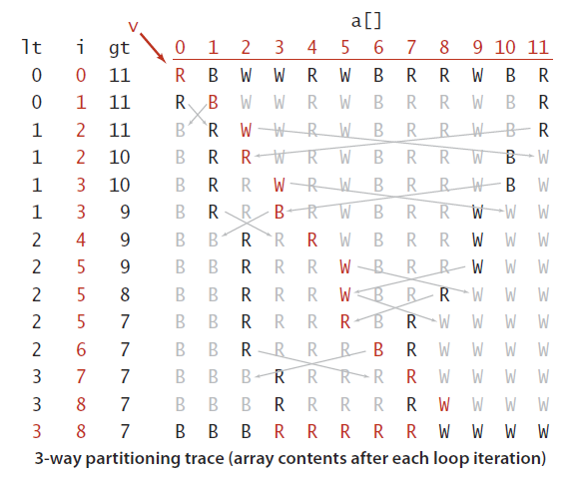
Dijkstra's 3-way partitioning: trace

Slide 72
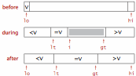
3-way quicksort: Java implementation
private static void sort(Comparable[] a, int lo, int hi)
{
if (hi <= lo) return;
int lt = lo, gt = hi;
Comparable v = a[lo];
int i = lo;
while (i <= gt)
{
int cmp = a[i].compareTo(v);
if (cmp < 0) exch(a, lt++, i++);
else if (cmp > 0) exch(a, i, gt--);
else i++;
}
sort(a, lo, lt - 1);
sort(a, gt + 1, hi);
}
Notes:
perhaps we should use this version on the t-shirt instead
Note: first two items compares are always equal (could initialize i = lo+1 instead, but trace on previous slide starts with i = lo)

Slide 73
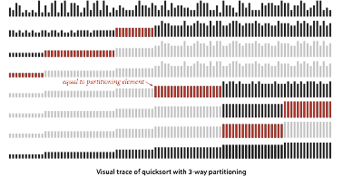
3-way quicksort: visual trace

Slide 74
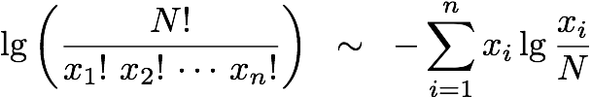
Duplicate keys: lower bound
Sorting lower bound. If there are n distinct keys and the i^{th} one occurs xi times, any compare-based sorting algorithm must use at least
compares in the worst case.
Proposition. [Sedgewick-Bentley 1997]
Quicksort with 3-way partitioning is entropy-optimal.
Pf. [beyond scope of course]
Bottom line. Quicksort with 3-way partitioning reduces running time from linearithmic to linear in broad class of applications.
N lg N when all distinct; linear when only a constant number of distinct keys
proportional to lower bound
Notes:
[wayne s14] a bit too technical for most students to digest

Slide 75
Sorting summary
 | inplace? | stable? | best | average | worst | remarks
selection | ✔ |  | ½ N ² | ½ N ² | ½ N ² | N exchanges
insertion | ✔ | ✔ | N | ¼ N ² | ½ N ² | use for small N or partially ordered
shell | ✔ |  | N log3 N | ? | c N ^{3/2} | tight code; subquadratic
merge |  | ✔ | ½ N lg N | N lg N | N lg N | N log N guarantee; stable
timsort |  | ✔ | N | N lg N | N lg N | improves mergesort when preexisting order
quick | ✔ |  | N lg N | 2 N ln N | ½ N ² | N log N probabilistic guarantee; fastest in practice
3-way quick | ✔ |  | N | 2 N ln N | ½ N ² | improves quicksort when duplicate keys
? | ✔ | ✔ | N | N lg N | N lg N | holy sorting grail
Notes:
stable inplace mergesort achieves the holy grail, but is impractical

Slide 76
2.3 Quicksort
quicksort
selection
duplicate keys
system sorts
http://algs4.cs.princeton.edu

Slide 77
2.3 Quicksort
quicksort
selection
duplicate keys
system sorts
http://algs4.cs.princeton.edu

Slide 78
Sorting applications
Sorting algorithms are essential in a broad variety of applications:
Sort a list of names.
Organize an MP3 library.
Display Google PageRank results.
List RSS feed in reverse chronological order.
Find the median.
Identify statistical outliers.
Binary search in a database.
Find duplicates in a mailing list.
Data compression.
Computer graphics.
Computational biology.
Load balancing on a parallel computer. . . .
obvious applications
problems become easy once items
are in sorted order
non-obvious applications
Notes:
Reminder of why sorting is so important.
Once a set of items is sorted, many other problems become easy.
Data compression = burrows wheeler transform.
supply chain management = schedule jobs of varying length to minimize (weighted) completion time
Computer graphics = convex hull, collinear points
particle simulation usually involves sorting N keys in the range 1 to O(N), but might be done for huge inputs - can be N-body simulation (ala Barnes-Hut variant) or for collision detection
Computational biology = longest common substring

Slide 79
War story (system sort in C)
A beautiful bug report. [Allan Wilks and Rick Becker, 1991]
We found that qsort is unbearably slow on "organ-pipe" inputs like "01233210": main (int argc, char**argv) { int n = atoi(argv[1]), i, x[100000]; for (i = 0; i < n; i++) x[i] = i; for ( ; i < 2*n; i++) x[i] = 2*n-i-1; qsort(x, 2*n, sizeof(int), intcmp); }
Here are the timings on our machine: $ time a.out 2000 real 5.85s $ time a.out 4000 real 21.64s $time a.out 8000 real 85.11s
Notes:
a succinct and beautiful bug report
AT&T Bell Labs
organ pipe array = 0 1 2 3 4 5 5 4 3 2 1 0
Version 7 Unix = landmark release of Unix and first widely-distributed release (e.g., added make, tar, malloc)

Slide 80



War story (system sort in C)
Bug. A qsort() call that should have taken seconds was taking minutes.
At the time, almost all qsort() implementations based on those in:
Version 7 Unix (1979): quadratic time to sort organ-pipe arrays.
BSD Unix (1983): quadratic time to sort random arrays of 0s and 1s.
Why is qsort() so slow?
Notes:
organ pipe array = 0 1 2 3 4 5 5 4 3 2 1 0. Bad case for median-of-3 where 3 keys are first, last, and middle.
Version 7 Unix = landmark release of Unix and first widely-distributed release (e.g., added make, tar, malloc)

Slide 81
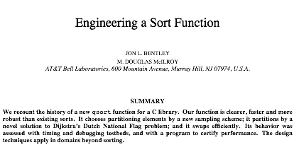
Engineering a system sort (in 1993)
Basic algorithm = quicksort.
Cutoff to insertion sort for small subarrays.
Partitioning scheme: Bentley-McIlroy 3-way partitioning.
Partitioning item.
small arrays: middle entry
medium arrays: median of 3
large arrays: Tukey's ninther [next slide]
Now very widely used. C, C++, Java 6, ….
similar to Dijkstra 3-way partitioning
(but fewer exchanges when not many equal keys)
Notes:
Paper from 1993
this paper was very influential and resulting algorithm is very widely used

Slide 82
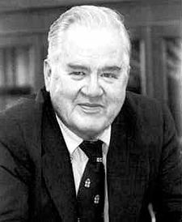
Tukey's ninther
Tukey's ninther. Median of the median of 3 samples, each of 3 entries.
Approximates the median of 9.
Uses at most 12 compares.
Q. Why use Tukey's ninther?
A. Better partitioning than random shuffle and less costly.
nine evenly spaced entries
R
L
A
P
M
C
G
A
X
Z
K
R
B
R
J
J
E
groups of 3
R
A
M
G
X
K
B
J
E
medians
M
K
E
ninther
K
Notes:
Tukey = famous Princeton statistician
Median: Number of comparisons close to N log₂N; FEWER large files; Slightly more exchanges, overhead.
Tukey's ninther uses less comparisons to get approximate median of 9 than is theoretically possible to get true median of 9
idea borrowed from statistics, useful in many disciplines
If the 9 samples are chosen uniformly at random, this reduces the number of compares to 1.57 N ln N

Slide 83
Bentley-McIlroy 3-way partitioning demo
Phase I. Repeat until i and j pointers cross.
Scan i from left to right so long as (a[i] < a[lo]).
Scan j from right to left so long as (a[i] > a[lo]).
Exchange a[i] with a[j].
If (a[i] == a[lo]), exchange a[i] with a[p] and increment p.
If (a[j] == a[lo]), exchange a[j] with a[q] and decrement q.
p
q
P | A | B | X | W | P | P | V | P | D | P | C | Y | Z
lo
i
j

Slide 84
Bentley-McIlroy 3-way partitioning demo
Phase II. Swap equal keys to the center.
Scan j and p from right to left and exchange a[j] with a[p].
Scan i and q from left to right and exchange a[i] with a[q].
A | D | B | C | P | P | P | P | P | Z | W | X | V | Y
lo
j
i
hi
3-way partitioned

Slide 85
Bentley-McIlroy 3-way partitioning
Phase I. Partition items into four parts:
No larger entries to left of i.
No smaller entries to right of j.
Equal entries to left of p.
Equal entries to right of q.
Phase II. Swap equal keys to the center.
All the right properties.
In-place.
Not much code.
Linear time if keys are all equal.
Small overhead if no equal keys.
v | = v | < v |  | > v | = v
lo
p
i
j
q
hi
Notes:
do step-by-step trace demo in 23Partitioning.key
if a[i] = v, swap a[i] and a[p++]
if a[j] = v, swap a[j] and a[q--]
otherwise do standard quicksort partitioning (stopping on a[i] if a[i] > v; stopping on a[j] if a[j] < v; and swapping a[i] and a[j])

Slide 86
Bentley-McIlroy 3-way partitioning: Java implementation
private static void sort(Comparable[] a, int lo, int hi)
{
if (hi <= lo) return;
int i = lo, j = hi+1;
int p = lo, q = hi+1;
while(true)
{
Comparable v = a[lo];
while (less(a[++i], v)) if (i == hi) break;
while (less(v, a[--j])) if (j == lo) break;
if (i >= j) break;
exch(a, i, j);
if (eq(a[i], v)) exch(a, ++p, i);
if (eq(a[j], v)) exch(a, --q, j);
}
exch(a, lo, j);
i = j + 1;
j = j - 1;
for (int k = lo+1; k <= p; k++) exch(a, k, j--);
for (int k = hi; k >= q; k--) exch(a, k, i++);
sort(a, lo, j);
sort(a, i, hi);
}
swap equal keys to left or right
swap equal keys back to middle
recursively sort left and right

Slide 87
Engineering a system sort (in 1993)
Basic algorithm for sorting primitive types = quicksort.
Cutoff to insertion sort for small subarrays.
Partitioning item: median of 3 or Tukey's ninther.
Partitioning scheme: Bentley-McIlroy 3-way partitioning.
Very widely used. C, C++, Java 6, ….
samples 9 items
similar to Dijkstra 3-way partitioning
(but fewer exchanges when not many equal keys)
Notes:
In response to the bug report, Bentley and McIlroy set to work.
this 1993 paper was very influential and resulting algorithm is very widely used

Slide 88
A beautiful mailing list post (Yaroslavskiy, September 2011)
https://learnforeverlearn.com/yaro_web/
Replacement of quicksort in java.util.Arrays with new dual-pivot quicksort
Hello All,
I'd like to share with you new Dual-Pivot Quicksort which is faster than the
known implementations (theoretically and experimental). I'd like to propose
to replace the JDK's Quicksort implementation by new one.
...
The new Dual-Pivot Quicksort uses *two* pivots elements in this manner:
1. Pick an elements P1, P2, called pivots from the array.
2. Assume that P1 <= P2, otherwise swap it.
3. Reorder the array into three parts: those less than the smaller pivot,
those larger than the larger pivot, and in between are those elements
between (or equal to) the two pivots.
4. Recursively sort the sub-arrays.
The invariant of the Dual-Pivot Quicksort is:
[ < P1 | P1 <= & <= P2 } > P2 ]
...
http://mail.openjdk.java.net/pipermail/core-libs-dev/2009-September/002630.html
Notes:
Rather arrogant to think that your algorithm could beat the venerable quicksort.
But the experts quickly realized that he was on to something. Analysis flawed but algorithm not!

Slide 89
Dual-pivot quicksort
Use two partitioning items p1 and p2 and partition into three subarrays:
Keys less than p1.
Keys between p1 and p2.
Keys greater than p2.
Recursively sort three subarrays.
Note. Skip middle subarray if p1 = p2.
< p1 | p1 | ≥ p1 and ≤ p2 | p2 | > p2
lo
lt
gt
hi
degenerates to Dijkstra's 3-way partitioning
Notes:
Note. Degenerates to Dijkstra's 3-way partitioning if p1 = p2.

Slide 90
Dual-pivot partitioning demo
Initialization.
Choose a[lo] and a[hi] as partitioning items.
Exchange if necessary to ensure a[lo] ≤ a[hi].
S | E | A | Y | R | L | F | V | Z | Q | T | C | M | K
lo
hi
exchange a[lo] and a[hi]

Slide 91
Dual-pivot partitioning demo
Main loop. Repeat until i and gt pointers cross.
If (a[i] < a[lo]), exchange a[i] with a[lt] and increment lt and i.
Else if (a[i] > a[hi]), exchange a[i] with a[gt] and decrement gt.
Else, increment i.
< p1 | p1 | ≥ p1 and ≤ p2 | ? | p2 | > p2
lo
lt
i
gt
hi
K | E | A | F | R | L | M | C | Z | Q | T | V | Y | S
lo
lt
i
gt
hi

Slide 92
Dual-pivot partitioning demo
Finalize.
Exchange a[lo] with a[--lt].
Exchange a[hi] with a[++gt].
< p1 | p1 | ≥ p1 and ≤ p2 | p2 | > p2
lo
lt
gt
hi
C | E | A | F | K | L | M | R | Q | S | Z | V | Y | T
lo
lt
gt
hi
3-way partitioned

Slide 93
Dual-pivot quicksort
Use two partitioning items p1 and p2 and partition into three subarrays:
Keys less than p1.
Keys between p1 and p2.
Keys greater than p2.
Now widely used. Java 7, Python unstable sort, …
< p1 | p1 | ≥ p1 and ≤ p2 | p2 | > p2
lo
lt
gt
hi
Notes:
Actually, our version uses 1.866667 N ln N compares vs. 1.9 N ln N compares for Yaroslavskiy's version
Improvements. Take 5 random items, use 2nd and 4th largest for p1 and p2.
Proposition. [Wild and Nevel] 1.9 N ln N compares and 0.6 N ln N exchanges.

Slide 94
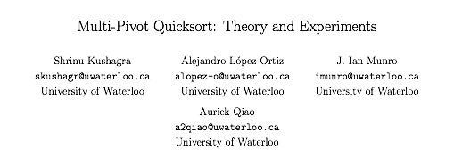
Three-pivot quicksort
Use three partitioning items p1, p2, and p3 and partition into four subarrays:
Keys less than p1.
Keys between p1 and p2.
Keys between p2 and p3.
Keys greater than p3.
< p1 | p1 | ≥ p1 and ≤ p2 | p2 | ≥ p2 and ≤ p3 | p3 | > p3
lo
a1
a2
a3
hi

Slide 95
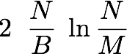
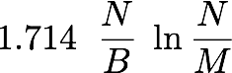
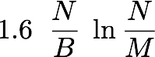
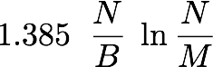
Performance
Q. Why do 2-pivot (and 3-pivot) quicksort perform better than 1-pivot?
A. Fewer compares?
A. Fewer exchanges?
A. Fewer cache misses.
Bottom line. Caching can have a significant impact on performance.
http://epubs.siam.org/doi/pdf/10.1137/1.9781611973198.6
https://arxiv.org/abs/1510.04676
partitioning | compares | exchanges | cache misses
1-pivot | 2 N ln N | 0.333 N ln N
median-of-3 | 1.714 N ln N | 0.343 N ln N
2-pivot | 1.9 N ln N | 0.6 N ln N
3-pivot | 1.846 N ln N | 0.616 N ln N
beyond scope
of this course
Notes:
Multiple choice question. How many compares and exchanges does 2-pivot quicksort do as compared to 1-pivot quicksort (with median-of-3 partitioning)?
More compares, more exchanges. Fewer compares, fewer exchanges, ….
median-of-3: 1.714 = 12/7, 0.343 = 12/35
3-pivot: 1.846 = 24/13, 0.615 = 8/13, 1.385 = 18/13
http://epubs.siam.org/doi/pdf/10.1137/1.9781611973198.6

Slide 96
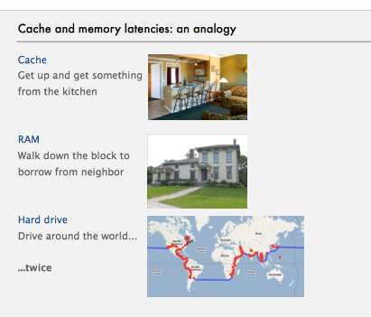
Cache and memory latencies
Cache. Get up and get something from the kitchen.
RAM. Walk down the block
to borrow from neighbor.
Hard drive. Drive around the world (twice).
mount of data brought into cache at one time.
Notes:
Typically more than one cache. We focus on cache closest to CPU.
main idea: speed up access to slower hardware by adding hardware that is faster than cheaper hardware but cheaper than faster hardware
Cache line = 64 bytes is typical
L1 cache 64K on MacbookPro
Which is faster: loop 1 or loop2? Same on most machines because array accesses is bottleneck and both fragments bring same memory into cache.
http://igoro.com/archive/gallery-of-processor-cache-effects/

Slide 97
Caching
Cache. High-speed memory between CPU and main memory.
Cache size. Size of cache.
Cache line. Amount of data brought into cache at one time.
Temporal locality. Access same item again (before it leaves cache).
Spatial locality. Access items nearby in memory (before they leave cache). Q. Which loop is faster?
Observation. Most programs exhibit both types of locality.
int[] a = new int[64 * 1024 * 1024];
for (int i = 0; i < a.length; i++)
a[i] *= 2;
int[] a = new int[64 * 1024 * 1024];
for (int i = 0; i < a.length; i += 16)
a[i] *= 2;
Notes:
Typically more than one cache (L1 and L2) and also caches for data/instructions. We focus on data cache closest to CPU.
main idea: speed up access to slower hardware by adding hardware that is faster than cheaper hardware but cheaper than faster hardware
Cache line = 64 bytes is typical
L1 cache 64K on MacbookPro
Which is faster: loop 1 or loop2? Same on most machines because array accesses is bottleneck and both fragments bring same memory into cache.
http://igoro.com/archive/gallery-of-processor-cache-effects/

Slide 98
Achilles heel in Bentley-McIlroy implementation (Java system sort)
Q. Based on all this research, Java’s system sort is solid, right?
A. No: a killer input.
Overflows function call stack in Java and crashes program.
Would take quadratic time if it didn’t crash first.
% more 250000.txt
0
218750
222662
11
166672
247070
83339
...
% java IntegerSort 250000 < 250000.txt
Exception in thread "main" java.lang.StackOverflowError
at java.util.Arrays.sort1(Arrays.java:562)
at java.util.Arrays.sort1(Arrays.java:606)
at java.util.Arrays.sort1(Arrays.java:608)
at java.util.Arrays.sort1(Arrays.java:608)
at java.util.Arrays.sort1(Arrays.java:608)
...
250,000 integers between 0 and 250,000
Java's sorting library crashes, even if you give it as much stack space as Windows allows
Notes:
more disastrous consequences in C

Slide 99

Achilles heel in Bentley-McIlroy implementation (Java system sort)
McIlroy's devious idea. [A Killer Adversary for Quicksort]
Construct malicious input on the fly while running system quicksort, in response to the sequence of keys compared.
Make partitioning item compare low against all items not seen during selection of partitioning item (but don't commit to their relative order).
Not hard to identify partitioning item.
Consequences.
Confirms theoretical possibility.
Algorithmic complexity attack: you enter linear amount of data; server performs quadratic amount of work.
Good news. Attack is not effective if sort() shuffles input array.
Q. Why do you think Arrays.sort() is deterministic?
Notes:
Why does Java system sort (and C qsort) use deterministic algorithm? Programmers like reproducibility when debugging. Wouldn't be a good idea for C qsort() since you could get different results if you have duplicate keys. Less problematic in Java since quicksort is only for primitive types. Bentley-McIlroy argue that library function shouldn't call rand() and have a side effect (but it could use its own).

Slide 100
Which sorting algorithm to use?
Many sorting algorithms to choose from:
sorts | algorithms
elementary sorts | insertion sort, selection sort, bubblesort, shaker sort, ...
subquadratic sorts | quicksort, mergesort, heapsort, shellsort, samplesort, ...
system sorts | dual-pivot quicksort, timsort, introsort, ...
external sorts | Poly-phase mergesort, cascade-merge, psort, .…
radix sorts | MSD, LSD, 3-way radix quicksort, …
parallel sorts | bitonic sort, odd-even sort, smooth sort, GPUsort, ...
Notes:
GPUsort maps the bitonic sorting network to GPUs (graphical processing unit) using simple texture mapping operations and effectively utilizes the memory bandwidth using cache-efficient memory accesses
shaker sort, cube sort, column sort.
http://gamma.cs.unc.edu/GPUSORT/index.html
Samplesort.
Basic algorithm = quicksort.
Sort a relatively large random sample from the array.
Use sorted elements as pivots.
Pivots are (probabilistically) good estimates of true medians.

Slide 101
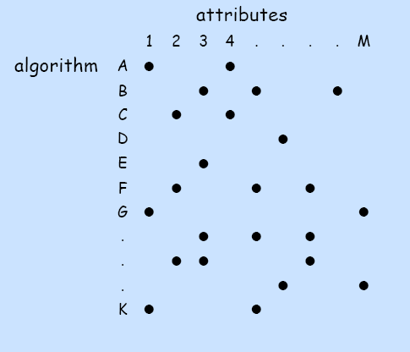
Which sorting algorithm to use?
Applications have diverse attributes.
Stable?
Parallel?
In-place?
Deterministic?
Duplicate keys?
Multiple key types?
Linked list or arrays?
Large or small items?
Randomly-ordered array?
Guaranteed performance?
Q. Is the system sort good enough?
A. Usually.
many more combinations of attributes than algorithms
Notes:
Elementary sort may be method of choice for some combination but cannot cover all combinations of attributes.

Slide 102

System sort in Java 7
Arrays.sort().
Has method for objects that are Comparable.
Has overloaded method for each primitive type.
Has overloaded method for use with a Comparator.
Has overloaded methods for sorting subarrays.
Algorithms.
Dual-pivot quicksort for primitive types.
Timsort for reference types.
Q. Why use different algorithms for primitive and reference types?
Notes:
Note: sedgewick interface uses sort(a, 0, N-1)
Why the difference? Stability unimportant with primitive types since there is no associated data. Mergesort uses extra memory , but if you are already using Objects, then maybe you won't care as much. Quicksort usually faster than mergesort on most inputs. Comparisons might be more expensive for objects and mergesort uses fewer comparisons.
A. Use of primitive types indicates time and space are critical.
A. Use of objects indicates time and space not so critical.

Slide 103
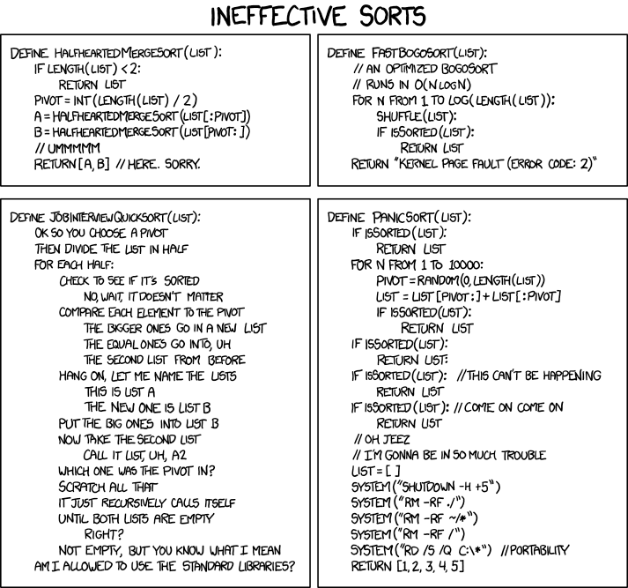
Ineffective sorts
http://xkcd.com/1185
Notes:
Here are a few more sorting algorithms...

Slide 104
Practice Session
Implement Dual-Pivot Quick sort in C++ for “dynamically created”, “randomly selected” 16K ( 2¹⁴) shorts (not integer) array.
short * A = new short [16384]
https://learnforeverlearn.com/yaro_web/

Slide 105
Practice Session
QuicksortYaro(A, left , right)
p = A[left]; q = A[right]
ℓ = left+1; k = ℓ; g = right - 1;
while k ≤ g
if A[k] < p
Swap A[k] and A[ℓ]
ℓ= ℓ + 1
else
if A[k] ≥ q // or if A[k] > q
while A[g] > q and k < g
g = g - 1
end while
Swap A[k] and A[g]
g = g - 1
if A[k] < p
Swap A[k] and A[ℓ]
ℓ = ℓ + 1
end if
end if
end if
k = k + 1
end while
ℓ = ℓ - 1 ; g = g + 1 ;
Swap A[left] and A[ℓ]
Swap A[right] and A[g]
QuicksortYaro(A, left , ℓ - 1)
QuicksortYaro(A, ℓ + 1, g - 1)
QuicksortYaro(A, g + 1 , right)

Slide 106
2.3 Quicksort
quicksort
selection
duplicate keys
system sorts
http://algs4.cs.princeton.edu

Slide 107
2.3 Quicksort
Algorithms
Robert Sedgewick | Kevin Wayne
quicksort
selection
duplicate keys
system sorts
http://algs4.cs.princeton.edu

Slide 108
Which sorting algorithm?
lifo fifo
data
type
hash
heap
sort
link
list
push
find
root
leaf
tree
null
path
node
left
less
exch
sink
swim
next
swap
find
fifo
data
exch
hash
heap
less
left
leaf
lifo
push
root
list
tree
null
path
node
link
sort
type
sink
swim
next
swap
data
fifo
find
hash
heap
lifo
link
list
push
root
sort
type
leaf
left
node
null
path
tree
exch
less
next
sink
swap
swim
data
fifo
find
hash
heap
lifo
link
list
push
root
sort
type
leaf
tree
null
path
node
left
less
exch
sink
swim
next
swap
data
exch
fifo
find
hash
heap
leaf
left
less
lifo
link
list
sort
tree
null
path
node
type
root
push
sink
swim
next
swap
data
fifo
lifo
type
hash
heap
link
sort
find
list
push
root
leaf
null
path
tree
exch
left
less
node
next
sink
swap
swim
hash
fifo
data
link
leaf
heap
exch
node
lifo
left
find
path
list
next
less
root
sink
swim
null
sort
type
tree
push
swap
data
exch
fifo
find
hash
heap
leaf
left
less
lifo
link
list
next
node
null
path
push
root
sink
sort
swap
swim
tree
type
original
?
?
?
?
?
?
sorted
Notes:
each column gives one of sorting algorithms at important intermediate stage (selection, insertion, shell, merge, merge BU, quick)

Slide 109
Which sorting algorithm?
original
quicksort
mergesort
lifo fifo
data
type
hash
heap
sort
link
list
push
find
root
leaf
tree
null
path
node
left
less
exch
sink
swim
next
swap
find
fifo
data
exch
hash
heap
less
left
leaf
lifo
push
root
list
tree
null
path
node
link
sort
type
sink
swim
next
swap
data
fifo
find
hash
heap
lifo
link
list
push
root
sort
type
leaf
left
node
null
path
tree
exch
less
next
sink
swap
swim
data
fifo
find
hash
heap
lifo
link
list
push
root
sort
type
leaf
tree
null
path
node
left
less
exch
sink
swim
next
swap
data
exch
fifo
find
hash
heap
leaf
left
less
lifo
link
list
sort
tree
null
path
node
type
root
push
sink
swim
next
swap
data
fifo
lifo
type
hash
heap
link
sort
find
list
push
root
leaf
null
path
tree
exch
left
less
node
next
sink
swap
swim
hash
fifo
data
link
leaf
heap
exch
node
lifo
left
find
path
list
next
less
root
sink
swim
null
sort
type
tree
push
swap
lifo fifo
data
type
hash
heap
sort
link
list
push
find
root
leaf
tree
null
path
node
left
less
exch
sink
swim
next
swap
find
fifo
data
exch
hash
heap
less
left
leaf
lifo
push
root
list
tree
null
path
node
link
sort
type
sink
swim
next
swap
data
fifo
find
hash
heap
lifo
link
list
push
root
sort
type
leaf
left
node
null
path
tree
exch
less
next
sink
swap
swim
data
fifo
find
hash
heap
lifo
link
list
push
root
sort
type
leaf
tree
null
path
node
left
less
exch
sink
swim
next
swap
data
exch
fifo
find
hash
heap
leaf
left
less
lifo
link
list
sort
tree
null
path
node
type
root
push
sink
swim
next
swap
data
fifo
lifo
type
hash
heap
link
sort
find
list
push
root
leaf
null
path
tree
exch
left
less
node
next
sink
swap
swim
hash
fifo
data
link
leaf
heap
exch
node
lifo
left
find
path
list
next
less
root
sink
swim
null
sort
type
tree
push
swap
data
exch
fifo
find
hash
heap
leaf
left
less
lifo
link
list
next
node
null
path
push
root
sink
sort
swap
swim
tree
type
data
exch
fifo
find
hash
heap
leaf
left
less
lifo
link
list
next
node
null
path
push
root
sink
sort
swap
swim
tree
type
insertion
selection
merge BU
shellsort
sorted

